Slide 1
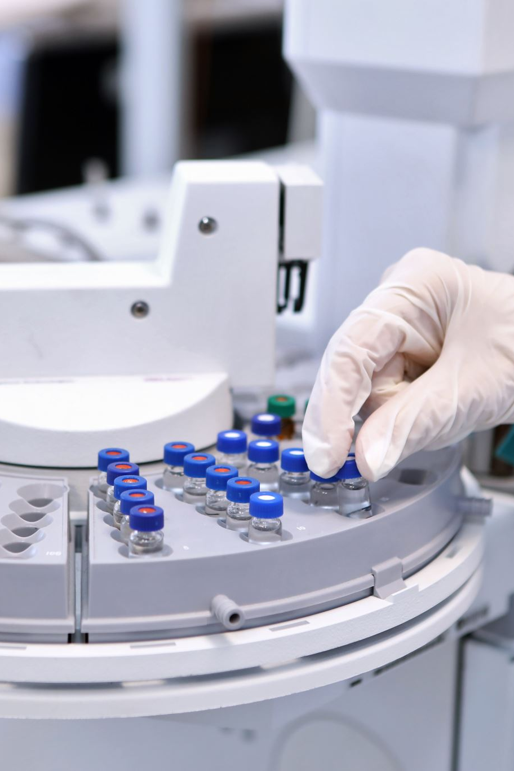
Immobilized beads in batch reactor
Laxman Manjhi 2019BB10034
Ratnesh Kumar Sharma 2019BB10047

Slide 2
Background
Enzyme immobilization is an important aspect of enzyme science and engineering.
Gel entrapment is a commonly used technique for immobilizing enzymes.
This technique involves the entrapment of enzymes within a polymeric network.
The shape and size of beads can be controlled by choosing the orifice diameter and the distance of the nozzle from the liquid surface.
Gel entrapment usually does not result in any adverse modification of the enzyme conformation.
High yield of immobilization can be achieved with gel entrapment.

Slide 3
Procedure
Two hundred milliliters of sucrose were taken.
Forty milliliters of beads were added to the batch reactor.
Samples were collected every 0, 10, 20, 30, 40, 50, and 60 minutes.
For the kinetic characterization of the calcium alginate beads, 50µL samples obtained from the reactor were taken.
Two hundred microliters of alkaline DNS were added to each sample.
The mixture was incubated at 90°C for 5 minutes.
Two hundred microliters of 50mM acetate, pH 4.8, were added to the mixture.
A blank (without enzyme) with sucrose, DNS, and acetate was also prepared and used as a control.
Absorbance readings were taken at 540nm, and the enzyme activity was calculated using a standard curve.
A dilution of 100X was performed.

Slide 4
Observation
Time | Abs
0 min | 0.03
10 min | -0.404
20 min | -0.444
30 min | 1.511
40 min | -0.474
50 min | -0.327
60 min | 0.633
Dilution | 100X

Slide 5
Enzyme activity
Time (min) | Abs | ε (mM^-1 cm^-1 | l (cm) | Df | C2 (mM) | ΔC (mM) | Δt (min) | Activity
0 | 0.03 | 14.2 | 1 | 100 | 0.211
10 | -0.404 | 14.2 | 1 | 100 | -2.845 | 3.06 | 10 | 0.31
20 | -0.444 | 14.2 | 1 | 100 | -3.127 | 0.28 | 10 | 0.03
30 | 1.511 | 14.2 | 1 | 100 | 10.641 | -13.77 | 10 | -1.38
40 | -0.474 | 14.2 | 1 | 100 | -3.338 | 13.98 | 10 | 1.40
50 | -0.327 | 14.2 | 1 | 100 | -2.303 | -1.04 | 10 | -0.10
60 | 0.633 | 14.2 | 1 | 100 | 4.458 | -6.76 | 10 | -0.68

Slide 7
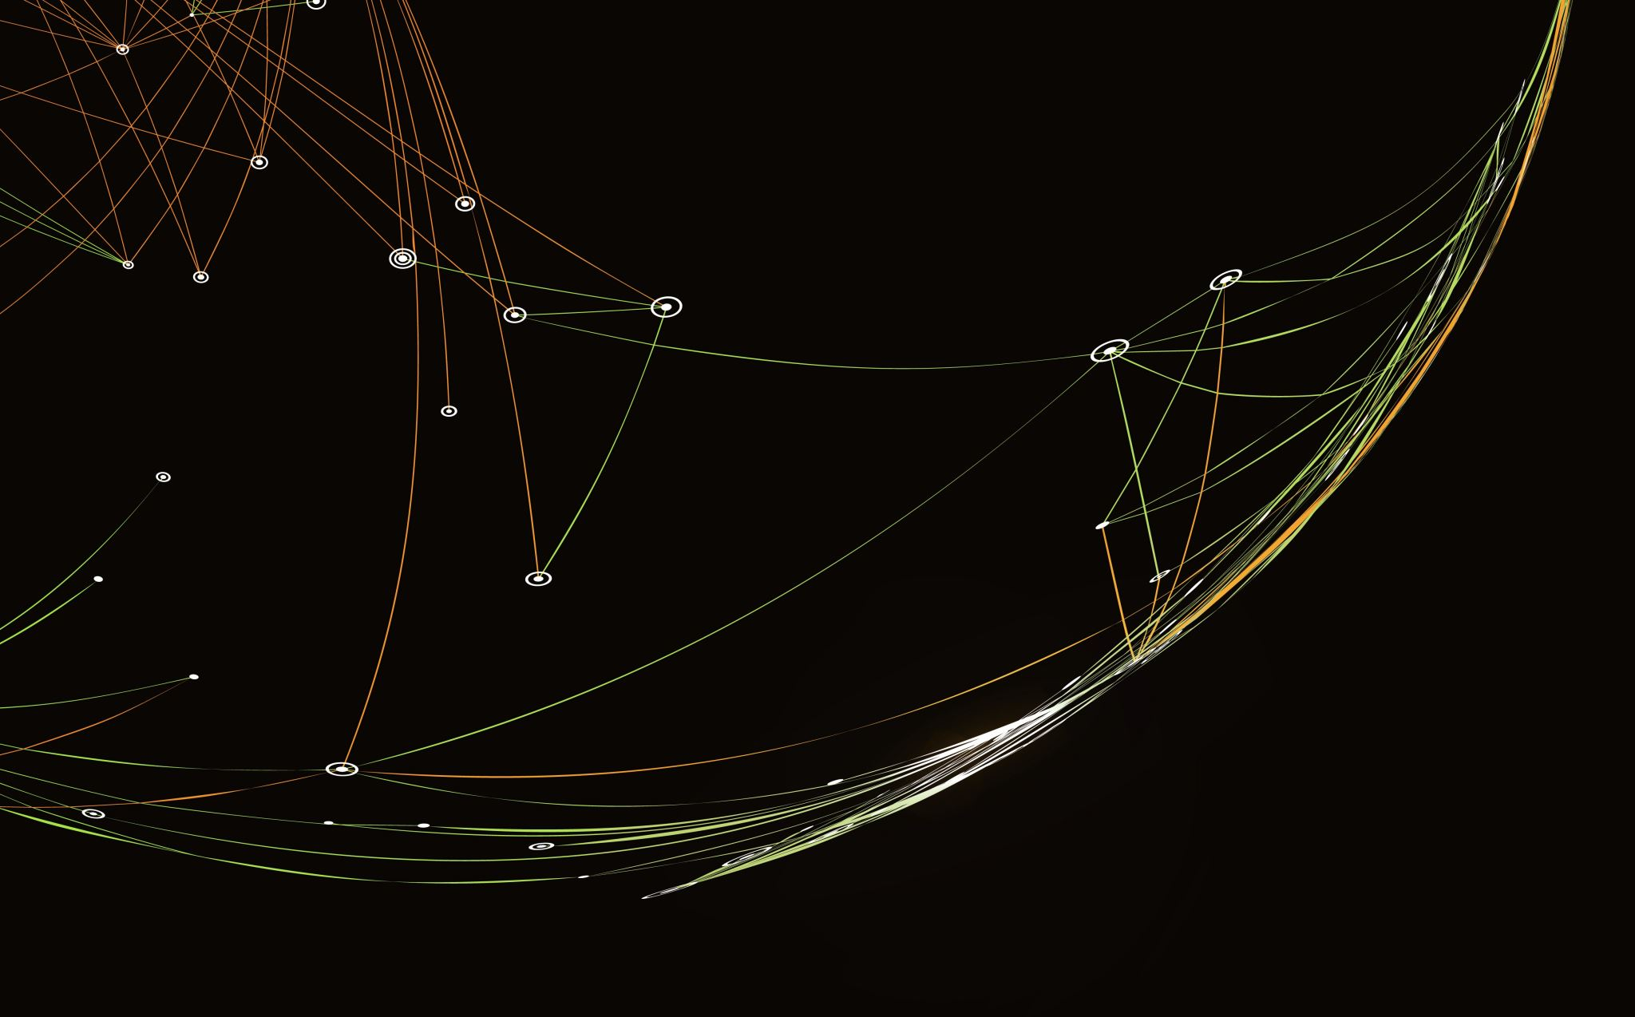
Thank you

